Slide 1

Modelling the impact of DNA sequence repeats on gene inversions and gene-strand bias in bacteria
Data science minor project presentation
Siva Subramanian A
IMS19217

Slide 2


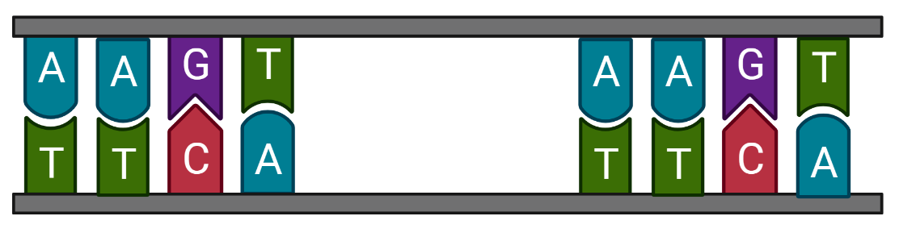
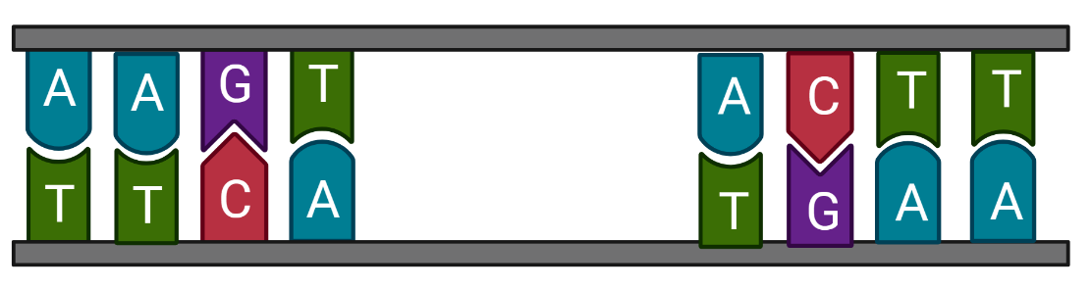
Graphical representation of the genome model
Inter replicore inverted repeats
Intra replicore inverted repeats
Direct repeats
Direct repeat pair
Inverted repeat pair

Slide 3
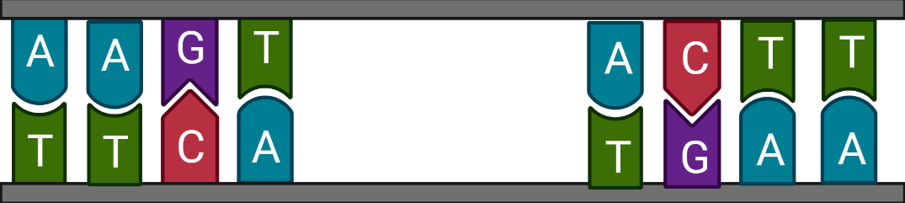
Background
Gene inversions: where a segment of the genome breaks off & reattaches in the reverse direction
Gene strand bias: uneven distribution of genes in leading and lagging strands of the genome
In bacteria, gene-strand bias is impacted by gene-inversions
Gene
Gene
Modelled a bacterial genome on how frequency and distribution of DNA sequence repeats impacts gene inversions and thus gene-strand bias

Slide 4

Modelling conditions
Inversion by intra-inverted repeats
Individual repeat
(i) Direct – inverted
(ii) Inverted – direct
(b) Genes – flip (i) Leading to lagging
(ii) Lagging to leading
ori
ori
Genes are flipped from lagging to leading
Undergoes inversion
Conversion of direct to inverted repeats
ter
Leading gene Lagging gene
ter
Inverted repeat pair
Direct repeat pair

Slide 5


Modelling conditions
Inversion by inter-inverted repeats
Individual repeat
(i) Direct – inverted
(ii) Inverted – direct
(b) Genes – NO flip (i) Leading to lagging
(ii) Lagging to leading
ori
ori
Undergoes inversion
Conversion of inverted to direct repeats
ter
Leading gene Lagging gene
ter
ter

Slide 6
Model work flow diagram
Genome Model
Random repeat pair
Direct repeats
Inverted repeats
Next generation
Intra inverted
Inter inverted
Selection pressure
Selection pressure
Condition 1
Condition 2
Next generation
Next generation

Slide 7
Trail run on the model
Simulations entries | Parameter’s values
Repeats pairs | 500, 1000, 2000, 2500, 5000
Direct/Inverted repeat percent | 50-50%
Inverted repeat percent | 50%, 60%, 67% (inter/intra repeat= 1:1, 1.5:1, 2:1)
Genes | 400, 800, 1600, 2000, 4000
Initial gene-strand bias (Leading/lagging) | 20-80% range by ± 5%
Generations | 10,000
Notes:
Fixed parameter to demonstrate
Repeats – 5000
Direct/Inverted – 50/50
Inter/intra – 50/50
Genes – 4000

Slide 8
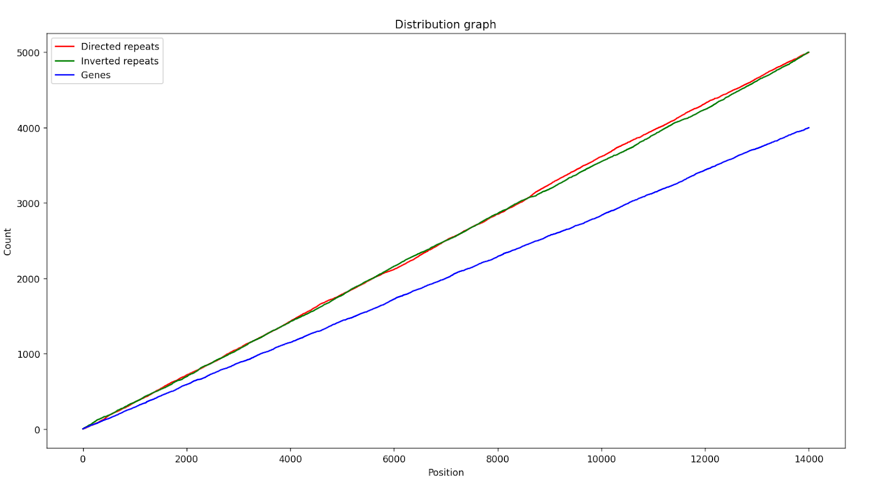
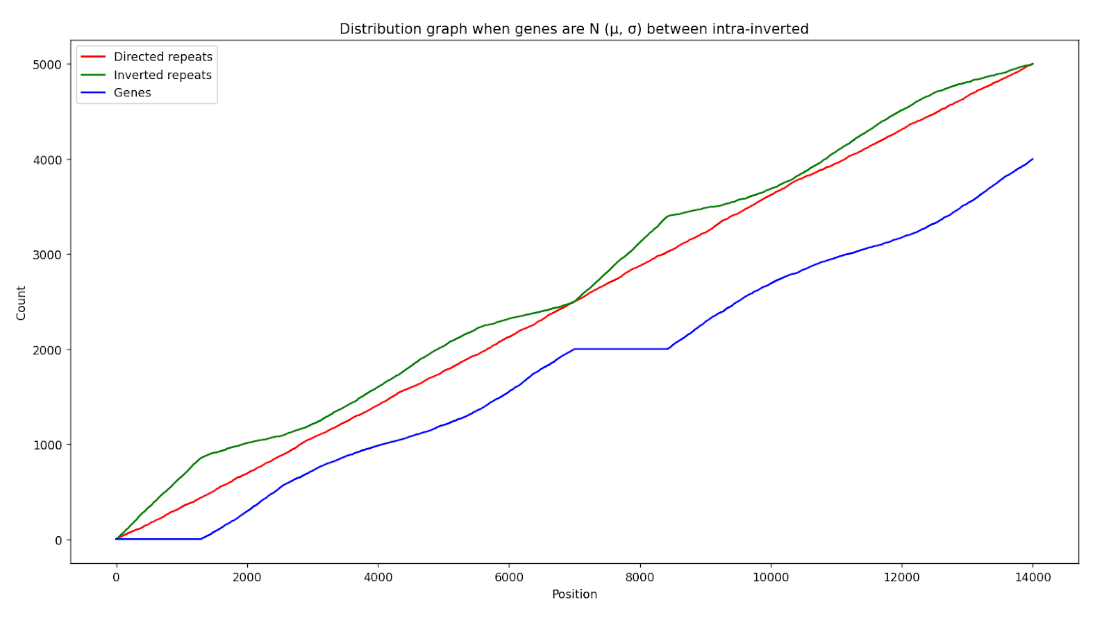
Validation – genes and repeats distribution
Parameters
Repeat pairs – 5000
Genes – 4000 Total – 14000 elements
(a) Stochastic distribution across the genome
(b) Genes are N(0.25, 0.05) intra-inverted repeats

Slide 9
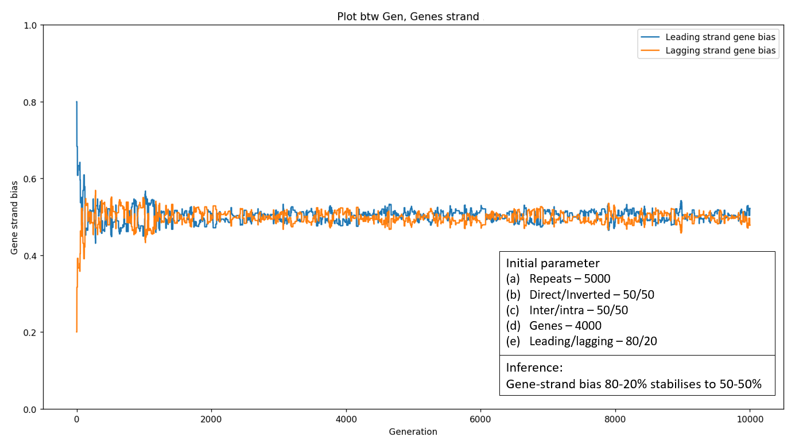
Simulations with no selection pressure

Slide 10
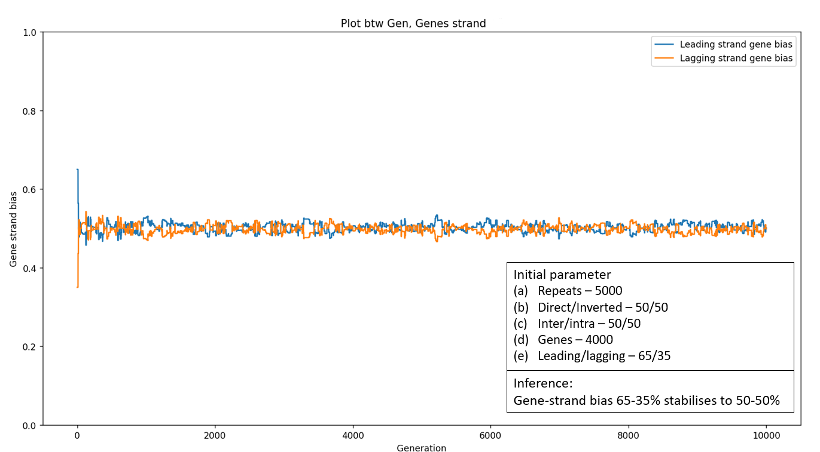
Simulations with no selection pressure

Slide 11
Selection pressure conditions
Inversions causing drastic gene imbalance between ori-ter and ter-ori gene counts are omitted
Selection pressure on inversion disparity score
The Inversion disparity score (IDS) is defined as the resulting sum of the genes by assigning a positive value (+1) to each leading gene and a negative value (-1) to each lagging gene between the intra-inverted repeated pair
E.g. Penalty limit (-10,10)
Leading and lagging strand genes = 5 and 4
IDS = +5 – 4 = 1
(b) Leading and lagging strand genes = 25 and 7
IDS = 25 – 7 = 18
Inversion happens
No Inversion
Notes:
: The ideal threshold ratio for the extreme gene count imbalance was kept at 0.25 if the ratio of ori-ter and ter-ori gene counts is within 0.25 then that inversion is accepted. (This value can be varied)

Slide 12
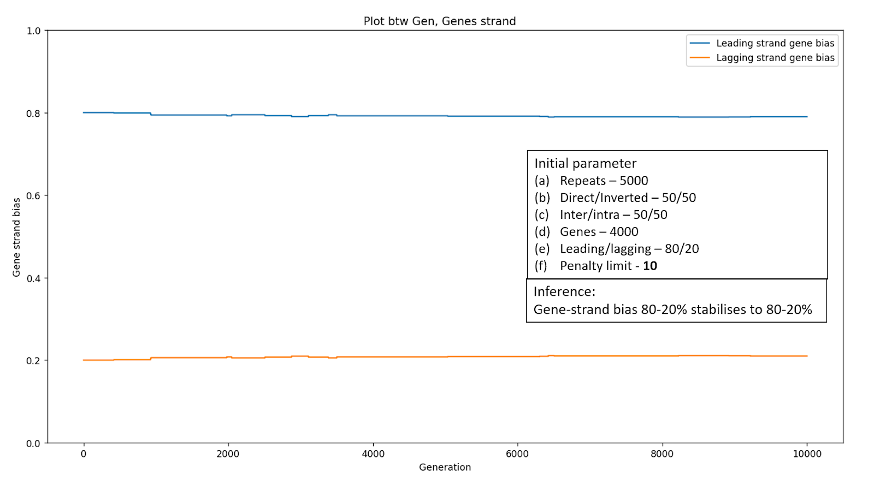
Simulations with selection pressure

Slide 13
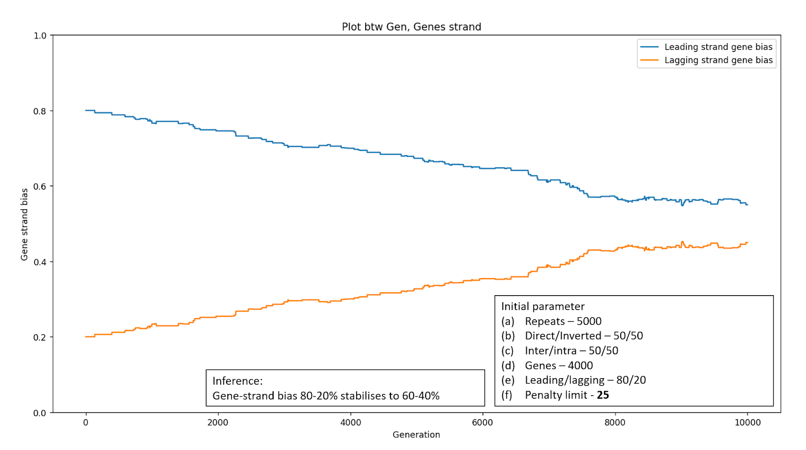
Simulations with selection pressure

Slide 14
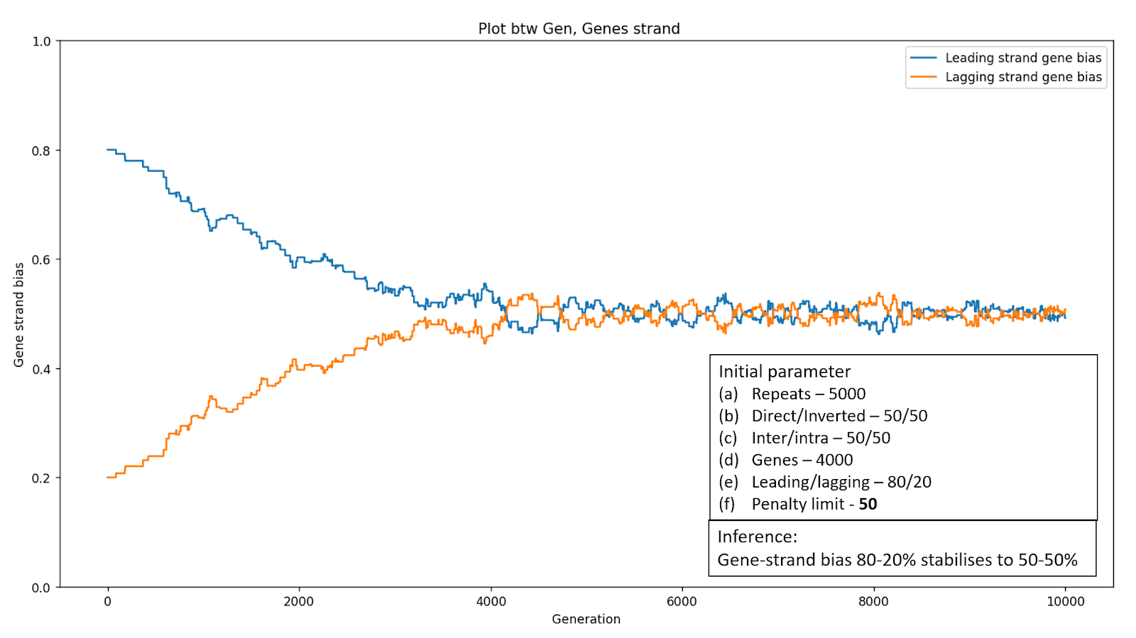
Simulations with selection pressure

Slide 15
Conclusions
Null model with no selection constraints – Gene-strand bias stabilizes at 50-50%
Model with selection constrains
Stringent disparity score is low – Gene-strand bias remains constant
Increasing the disparity score – Gene-strand bias decreases
Strengths
Simplistic model studying the inversion by repeats impacting the gene-strand bias.
Evolution of bacterial genome gene-strand bias – selection pressure
Population genetics – fitness for each gene
Notes:
Null model with no selection stabilizes the gene-strand bias to 50-50% and this predicts the evolutionary aspects model as no selection is imposed on the inversions, thus leading and lagging strand genes stabilizes to 50-50%.
The model with selection pressure imposed selection on the inversion based on gene imbalance and inversion score, thus the gene-strand bias is not affected. When the stringent inversion disparity score is low, gene strand bias remains constant and increasing inversion disparity limit, gene-strand bias decreases.

Slide 16
Thank you!
Dr Sabari Sankar Thirupathy
Atre Malhar Vivek
Members of Mutations lab

